Slide 1

Rule
2021 Jan| TSC Nanjing

Slide 2
Rule
Usage
If the communication parameters (like filename or subject) aren´t enough to find the correct process and the content of the file has to be taken into account, a rule can be used.
E-Trans
E-Trans is an EDI platform like SWORD, that routes and maps Messages.
For example, COS, CIEL and CTTS are connected to E-Trans.

Slide 3
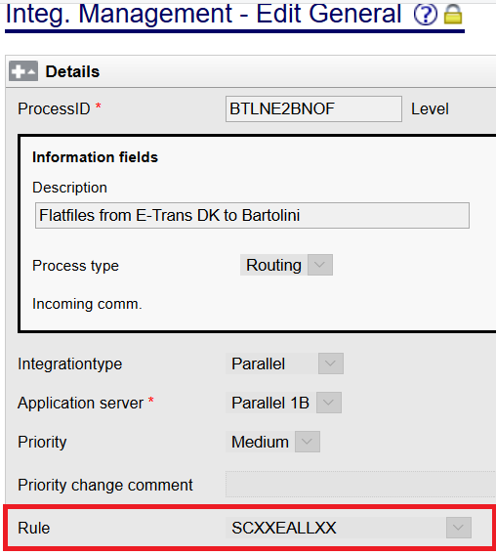
Receive from E-Trans
Use Rule: SCXXEALLXX in general page

Slide 4
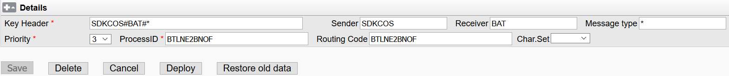
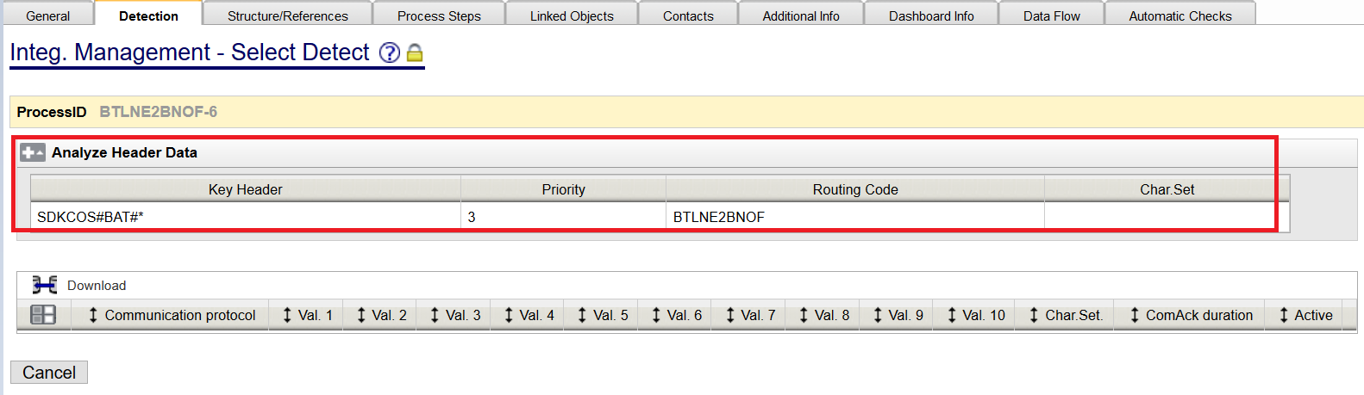
Receive from E-Trans
2. Configure in Analyze Header
3. Detection page no need to configure

Slide 5
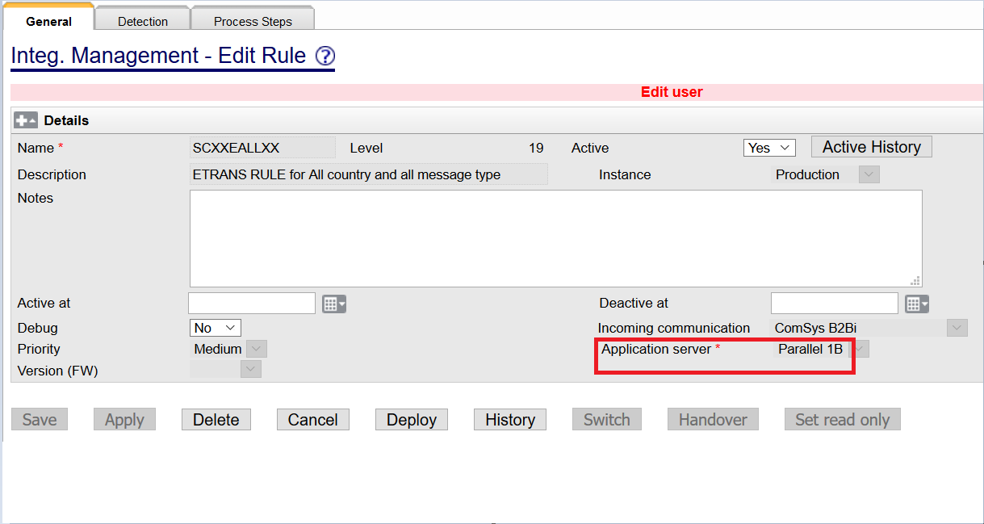
SCXXEALLXX

Slide 6
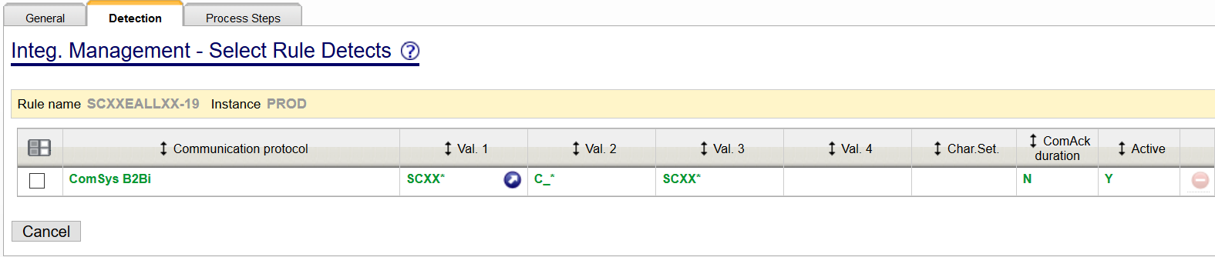
SCXXEALLXX

Slide 7
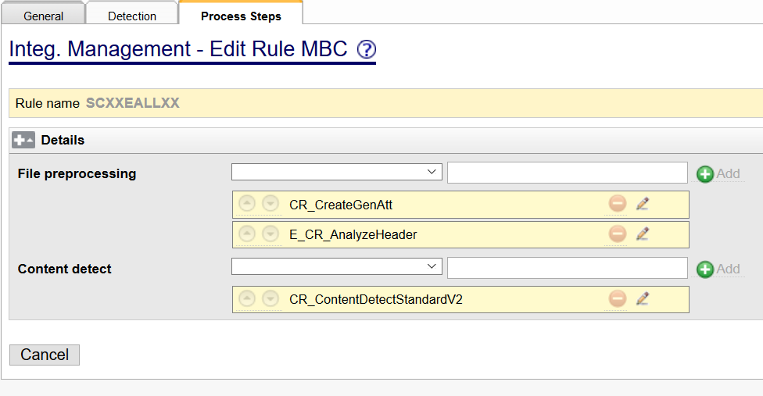
SCXXEALLXX
E_CR_AnalyzeHeader
The combination of sender, receiver and message type (concatenation character #
e.g. sender#receiver#messagetype) retrieved by E_CR_AnalyzeHeader is used as key to retrieve data from dynamic table DYN_ANALYZE_HEADER. In this dynamic table SWING sender, SWING receiver, SWING message type, ProcessId and routing code can be configured. The result is stored in attribute GenAtt. This attribute is evaluated in CR_ContentDetect and can be used to fetch references.

Slide 8
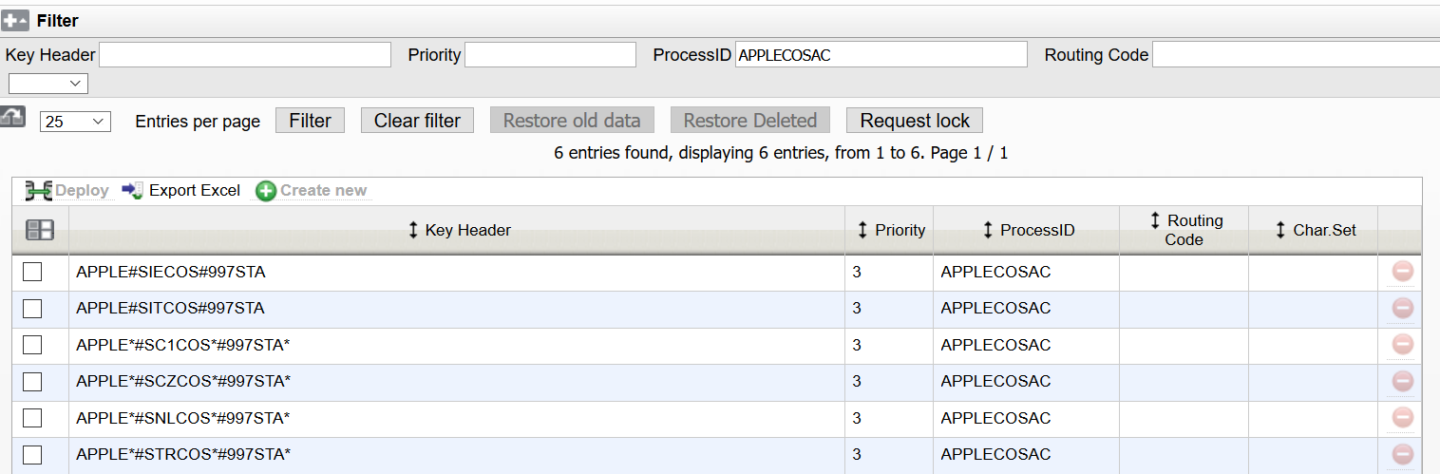
APPLECOSAC

Slide 9
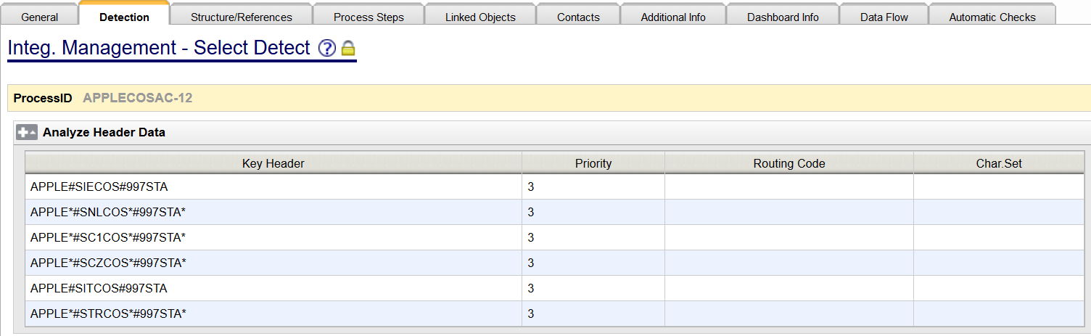
APPLECOSAC

Slide 10
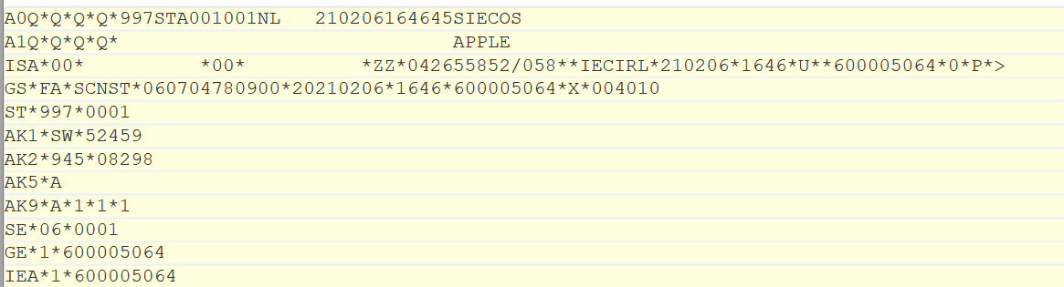
APPLECOSAC
GenAtt {{"GW_HOST","b2biprdapp5","OriginalSender","APPLE","OriginalReceiver","SIECOS","OriginalMessageType","997STA","ProcessId","APPLECOSAC"}}
COS: A0Q, A1Q
Sender: A1Q 40-80
Receiver: A0Q 40-74
Message Type: A0Q 11-16

Slide 11
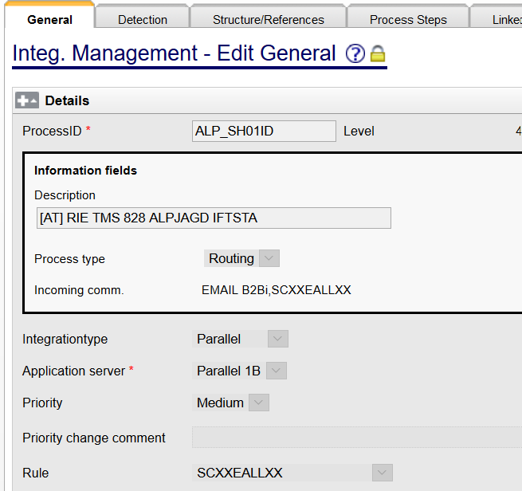
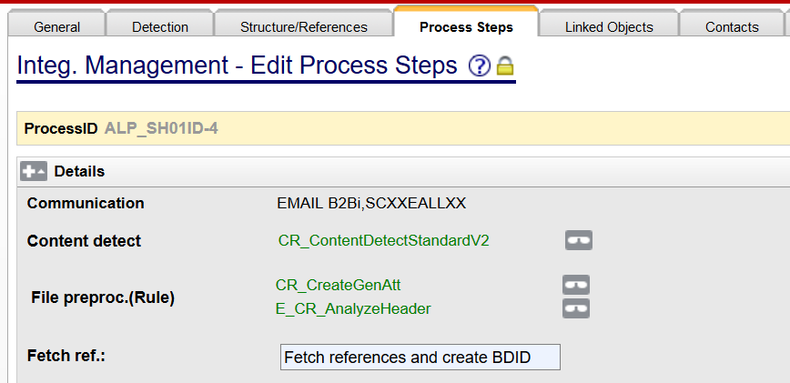
General page set rule

Slide 12
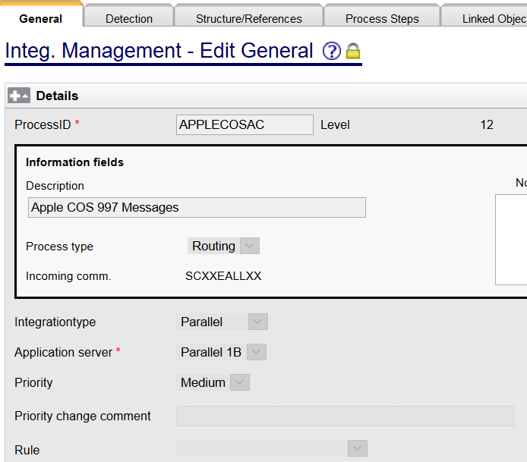
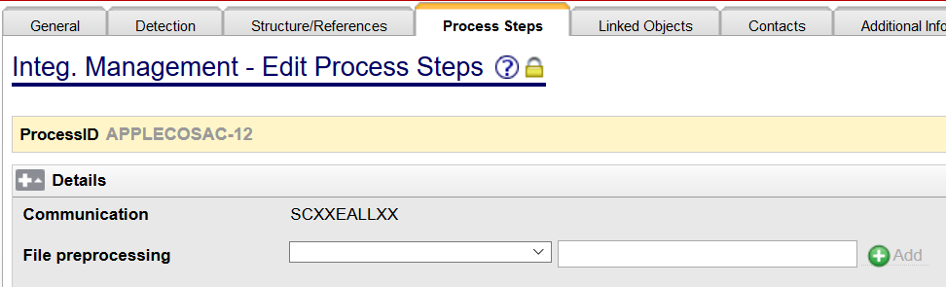
General page not set rule

Slide 13
E-Trans
From E-Trans
Except for EDIFACT, E-Trans sends files with A0Q/A1Q Header
80 characters a line
From COS: A0Q+A1Q
Example
A0Q*Q*Q*Q*XML 001001DKSDK190726090718PROAEALFA A1Q*Q*Q*Q* SDKCOS

Slide 14
COS
A0Q*Q*Q*Q*XML 001001DKSDK190726090718PROAEALFA A1Q*Q*Q*Q* SDKCOS
Description
Header | Position | Description | Length | Example
A0Q | 1-10 | Fixed value | 10 | “A0Q*Q*Q*Q*”
 | 11-16 | Message Type | 6 | “XML ”
 | 17-19 | Message Version | 3 | “001”
 | 20-22 | Message Release | 3 | “001”
 | 23-24 | Country | 2 | “DK “
 | 25-27 | Receiving office | 3 | “SDK“
 | 28-35 | Transmission Date | 9 | “190726090”
 | 36-39 | Transmission Time | 4 | “0718”
 | 40-74 | Receiver | 35 | “PROAEALFA”
 | 75 | Test indicator (“T” or <blank>) | 1 | <blank>
A1Q | 1-10 | Fixed value | 10 | “A1Q*Q*Q*Q*”
 | 11-24 | Application reference 1 | 14
 | 25-38 | Application reference 2 | 14
 | 39 | Test indicator | 1
 | 40-80 | Sender | 41 | “SDKCOS”

Slide 15
Other E-Trans partner
Example
A0Q*Q*Q*Q*IKAXML001001RAILTOOL SRC003
Description
Position | Description | Length | Example
1-10 | Fixed value | 10 | “A0Q*Q*Q*Q*”
11-16 | Message Type | 6 | “IKAXML”
17-19 | Message Version | 3 | “001”
20-22 | Message Release | 3 | “001”
23-39 | Sender | 17 | “RAILTOOL “
40-74 | Receiver | 35 | “SRC003 “
75 | Test indicator (“T” or <blank>) | 1 | <blank>

Slide 16
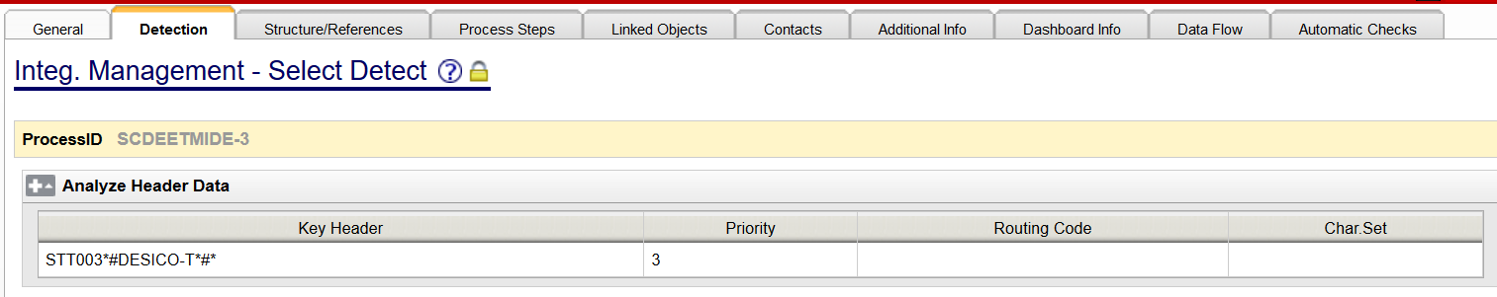
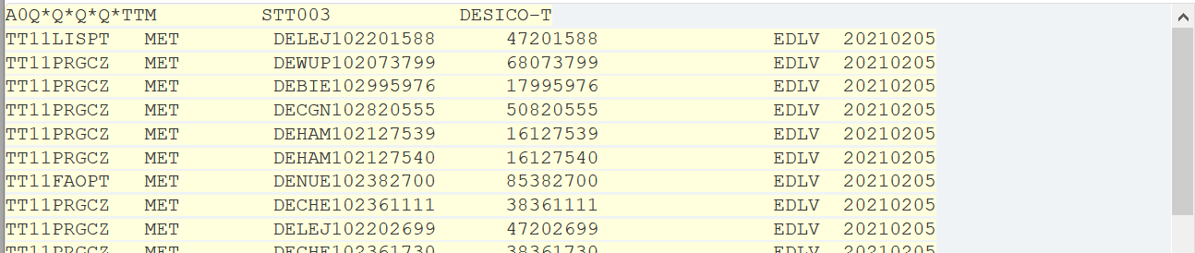
CTTS
A0Q
Sender: 23-39
Receiver: 40-74
Message Type: 11-16
GenAtt {{"GW_HOST","b2biprdapp5","OriginalSender","STT003","OriginalReceiver","DESICO-T","OriginalMessageType","TTM","ProcessId","SCDEETMIDE"}}

Slide 17
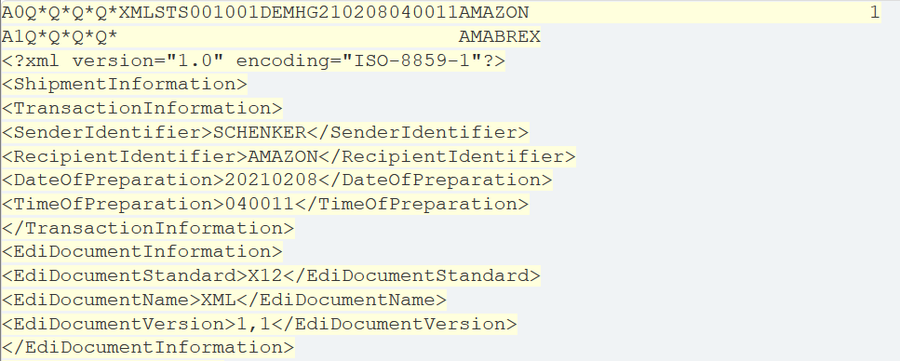
XML

Slide 18
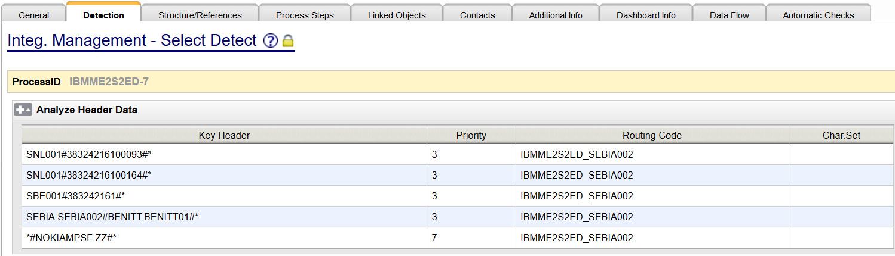
EDIFACT
Sender 3rd group of UNB record
Receiver 4th group of UNB record
Message Type 3rd group of UNH record
GenAtt {{"GW_HOST","b2biprdapp5","OriginalSender","SEBIA.SEBIA002","OriginalReceiver","BENITT.BENITT01","OriginalMessageType","IFTSTA:D:96A:UN:FIFS01","ProcessId","IBMME2S2ED","RoutingCode","IBMME2S2ED_SEBIA002"}}

Slide 19
Routing Code
If there is routing code configured in analyze table, and no routing code set in Process, then it will use routing code configured in analyze header table. If process also set a routing code, it will overwrite routing code configured in analyze header table.

Slide 20
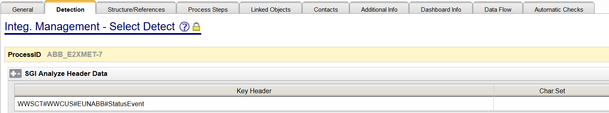
Receive SGI files from E-Trans
Use rule SGI_RULE
Configure SGI Analyze Header

Slide 21
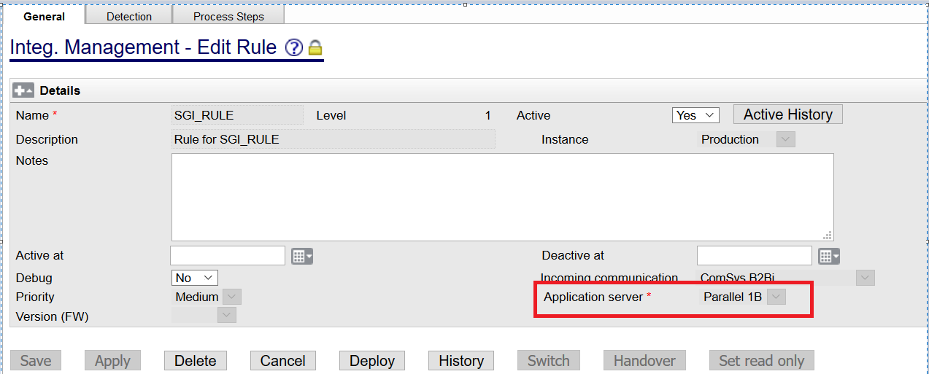
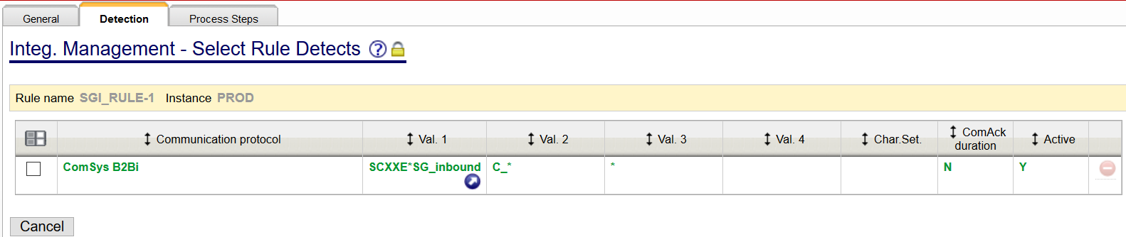
SGI_RULE

Slide 22
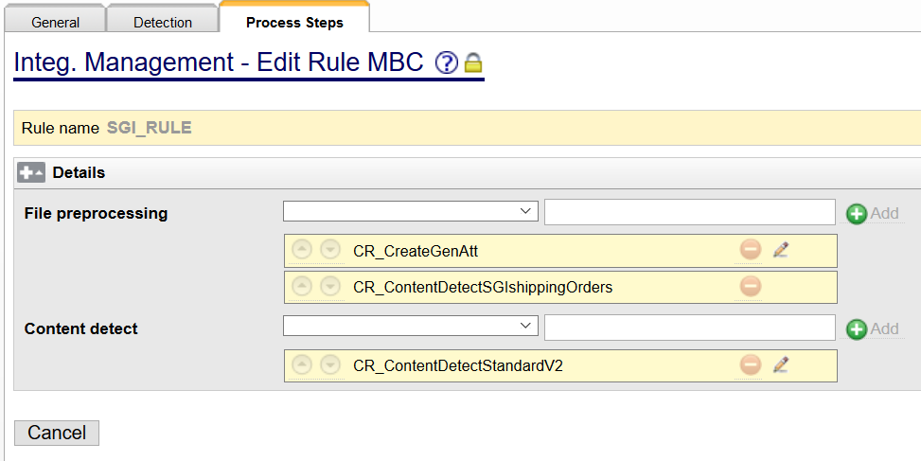
SGI_RULE
CR_ContentDetectSGIshippingOrders: retrieves the values of the following tags/attributes:
//Sender/systemID/
//receiver/receiver/SystemID/
//receiver/receiver/ReferenceID/@schemename
//sender/messageinfo/name
from the first 1000 characters of a file.

Slide 23
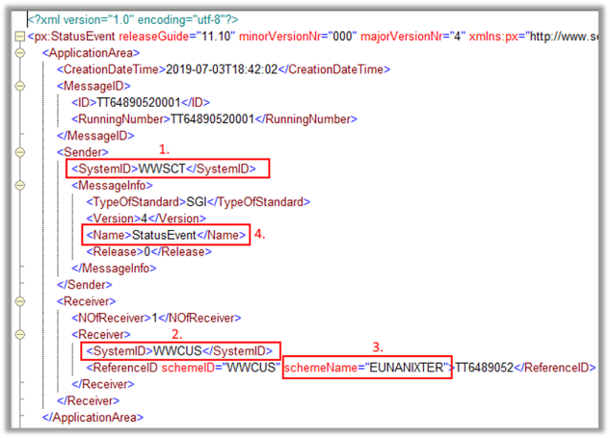
Receive SGI files from E-Trans

Slide 24
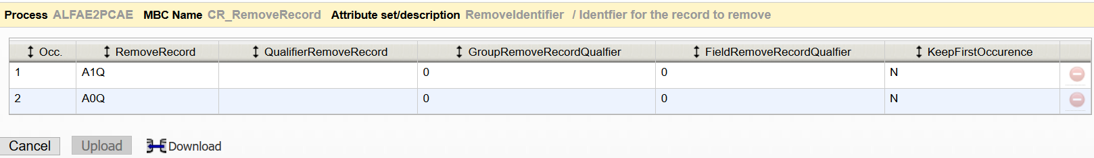
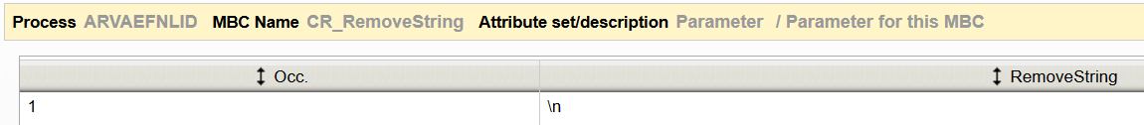
Receive from E-Trans
Notes:
Configure on 1B
File Preprocessing will be skipped
remove header and linefeed before send to partner
CR_RemoveRecord
CR_RemoveLineFeed
CR_RemoveString

Slide 25
Send to E-Trans
Unsegmented files need to be cut into 80 characters per line(CR_CutToLineLength)
A0Q/A1Q headers need to be added except EDIFACT
Use standard routing codes
CR_AddRec_v2
CR_AddHeaderFooter
CR_CutToLineLength

Slide 26
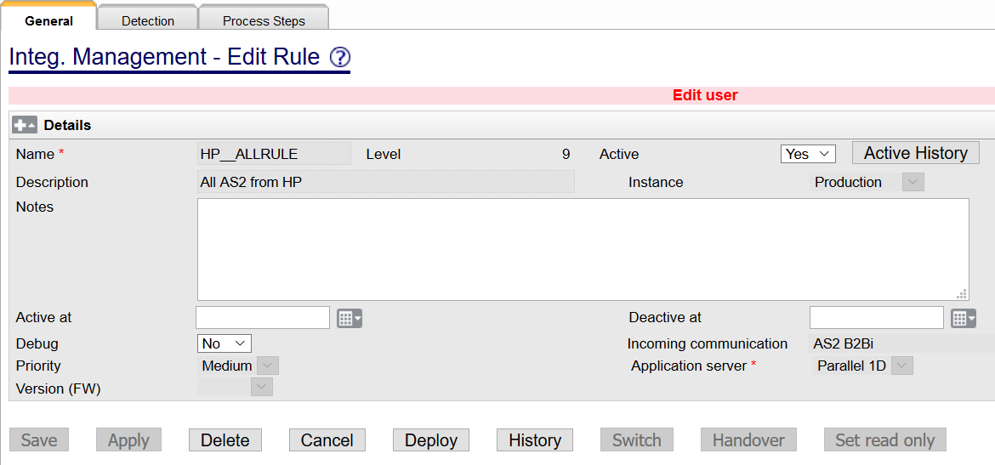
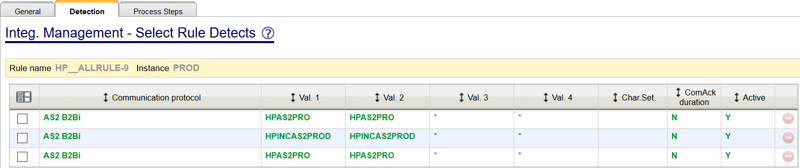
HP__ALLRULE

Slide 27
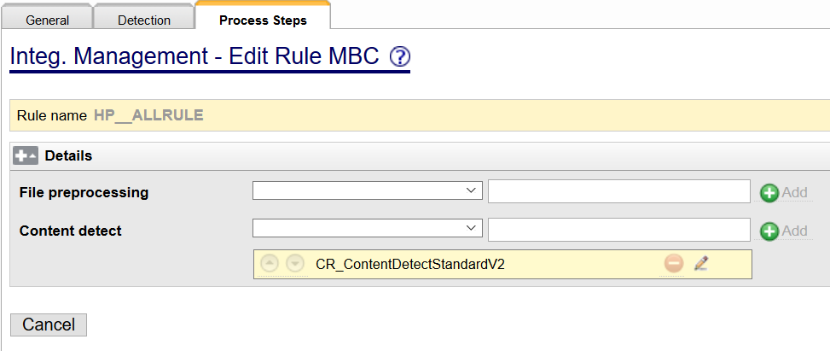
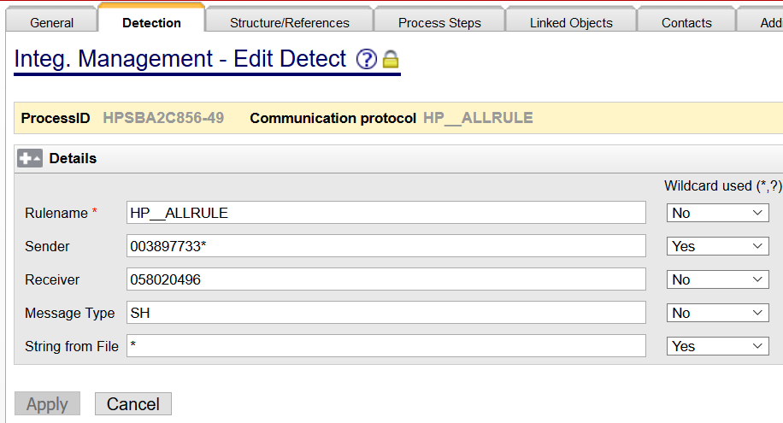
HP__ALLRULE

Slide 28
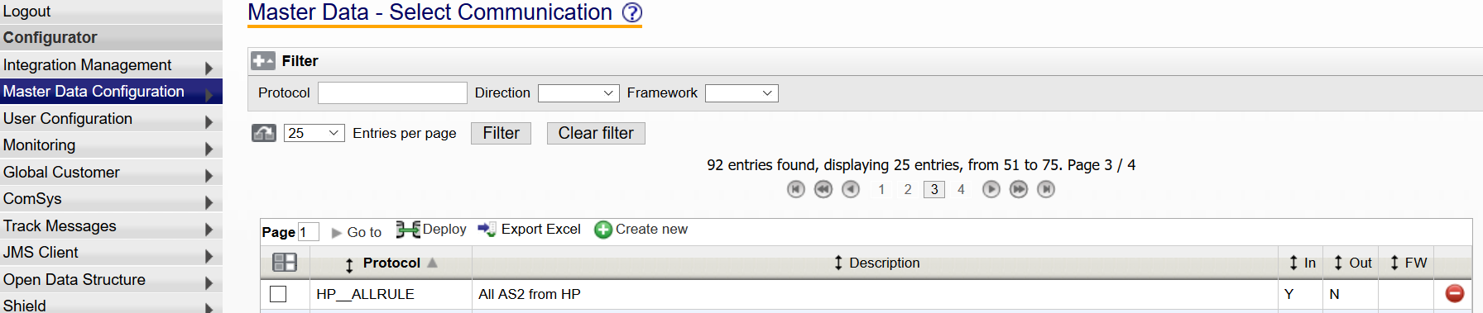
Set rule as communication protocol

Slide 29
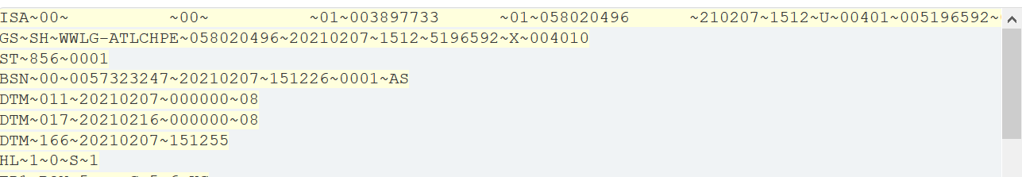
CR_ContentDetectStandardV2
AnsiX12
Sender 7th element of ISA record
Receiver 9th element of ISA record
Message Type 2nd element of GS record

Slide 30
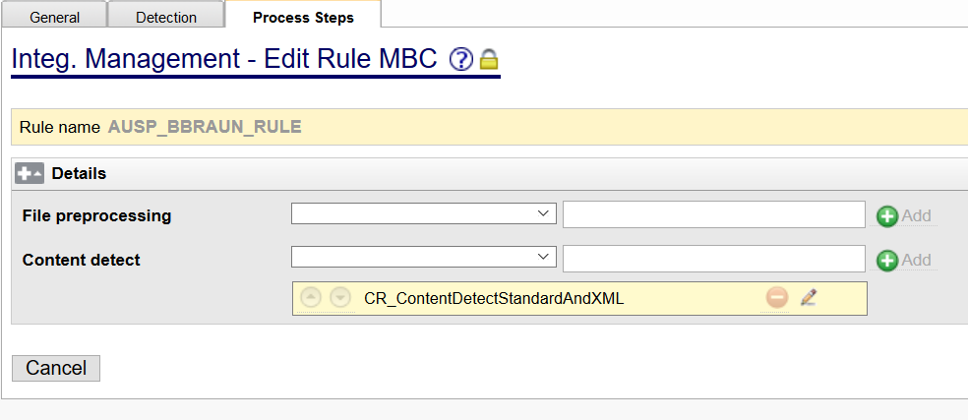
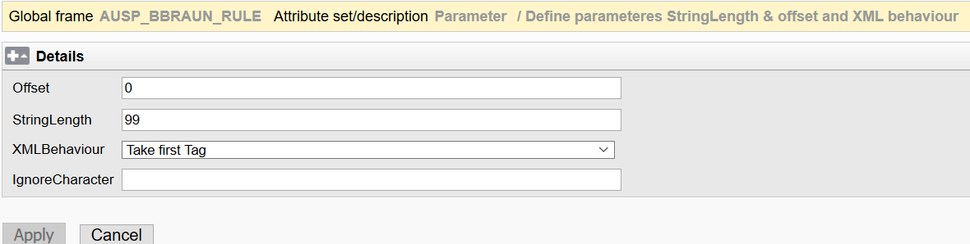
AUSP_BBRAUN_RULE
Offset: read from which position
StringLength: read how many length

Slide 31
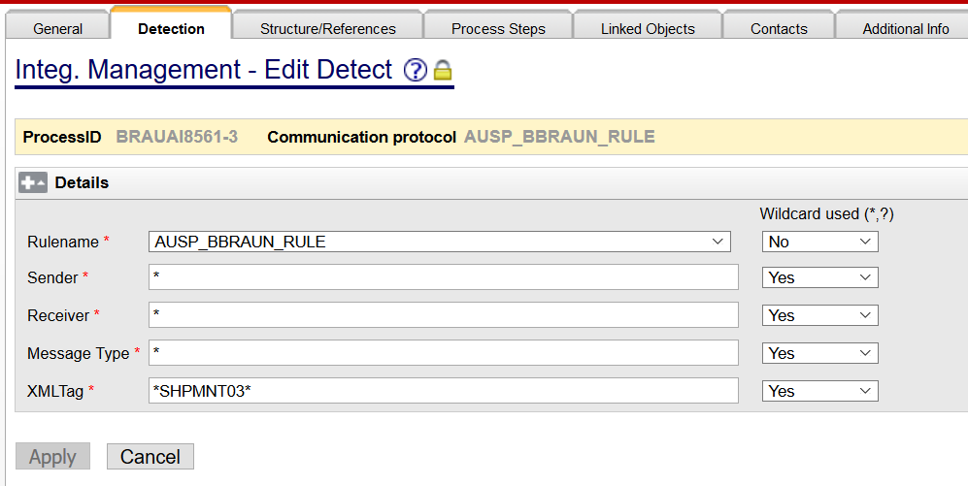
AUSP_BBRAUN_RULE

Slide 32
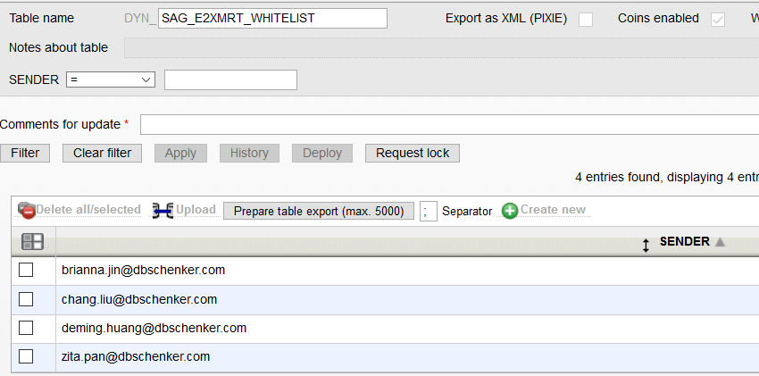


Email Whitelist
How to allow files from specific senders?
How to block files from specific email senders?
Step1
Create a dynamic table
Only one columns which will be filled in with e-mail addresses.
e.g. DYN_SAG_E2XMRT_WHITELIST

Slide 33
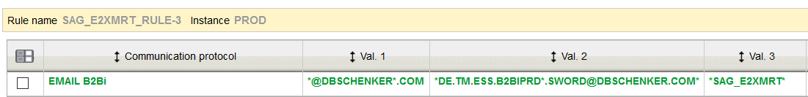
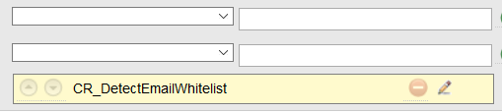

Email Whitelist
Step2
2. Create a new rule
In "Manage rules", create a new rule, select "Incoming communication" with "EMAIL B2Bi". Fill in "Detection" as usual.
Click "Process Step", select "CR_DetectEmailWhitelist", edit it and add the new table's name. eg. SAG_E2XMRT_RULE

Slide 34
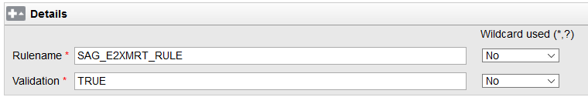
Email Whitelist
Step3
3. Add detection for a process
Select “Communication protocol” “EMAIL_WHITELIST”.
Fill the “Rulename” with the one you created
Fill the “Validation” field:
(1）IF “TURE”, then allow specific senders in the table to send files
(2) IF “FALSE”, then block specific senders in the table to send files
If you create a TEST RULE with your own test PID
Do remember to deactivate the RULE after testing
Otherwise, you will face SYSTXERROR (the email will be fetch for both rule and the test PID)

Slide 35
Thank you

